Slide 1

Laravel Virtual Training Middleware and Migration Elania Resources 12nd January 2023
Virtual Perak Technology

Slide 2
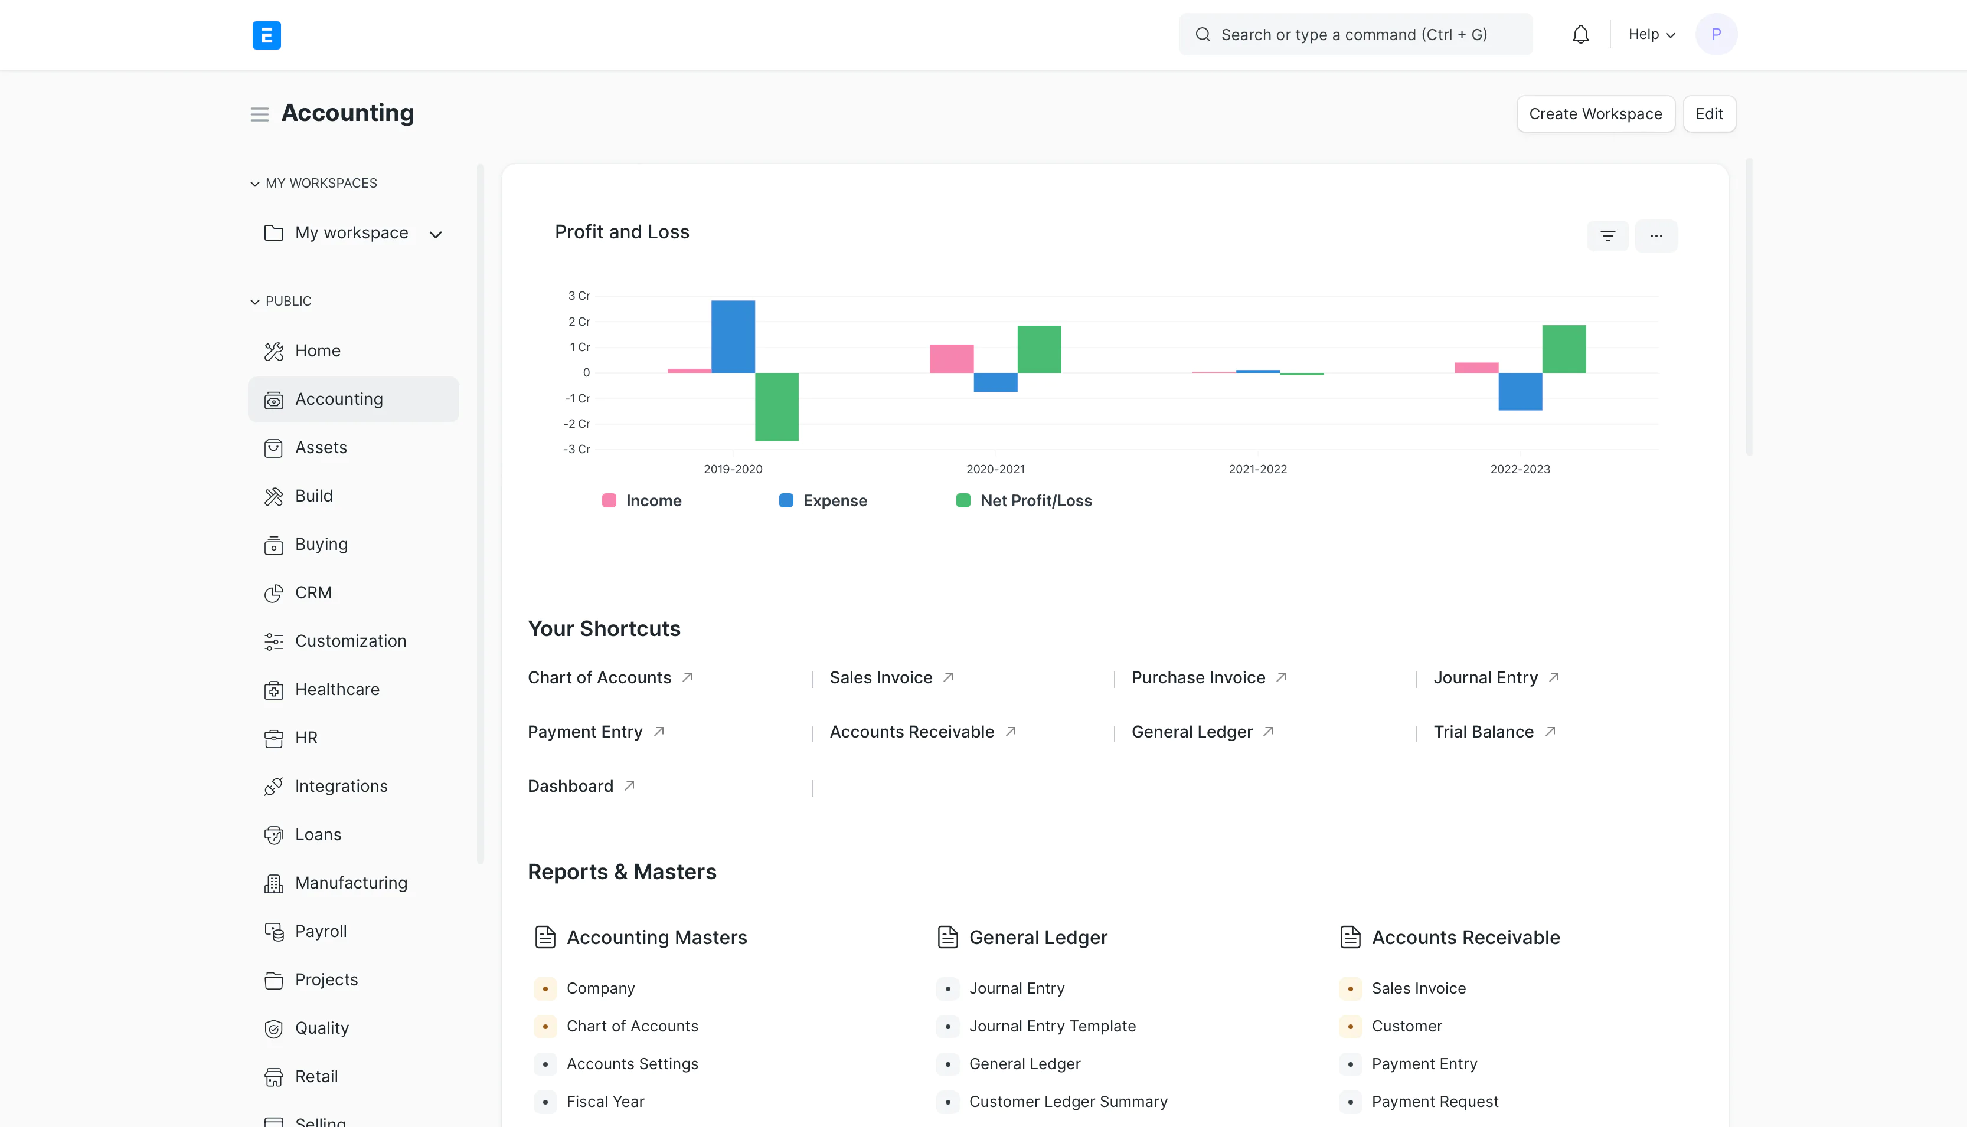
Elania Resources Updates
ERPNext Training And Service Provider
ERPNext Hosting (https://erpnext.my)

Slide 3
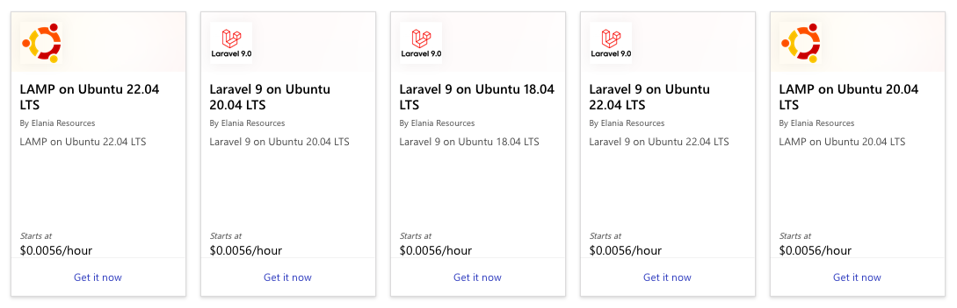
Elania Resources Updates
Authorized Microsoft Reseller
Authorized Adobe Reseller
Laravel and Ubuntu VM in Azure Marketplace

Slide 4
Recap
Laravel View
Nested View Directories
Passing Data To Views
Share Data With All Views
Laravel Livewire
Blade Template
Environment
Authentication
Laravel Breeze
Sessions
API Token
Authenticated User
Protecting Routes

Slide 5
Scopes
Laravel Middleware
Create Middleware
Perform Task
Register Middleware
Assign To Route
Exclude Middleware
Middleware Parameters
Laravel Migration
Generate Migrations
Squash Migration
Migration Structure
Running Migration
Roll Back Migration
Create Tables
Check Table/Column
Update Tables
Rename/Drop Table
Column Type
Column Modifier
Update Column
Rename Column
Drop Column
Create Indexes
Foreign Key

Slide 6
Laravel Middleware
Inspecting and filtering HTTP requests entering your application
Several middleware included in the Laravel
Authentication
CSRF protection.
Middleware are located in the app/Http/Middleware directory
Series of "layers" HTTP requests must pass through before they hit your application
Each layer can examine the request and even reject it entirely

Slide 7
Create Middleware
Create a new middleware using make:middleware
php artisan make:middleware CheckToken
Add the following code in the function handle()
public function handle($request, Closure $next){
if ($request->input('token') !== ‘percubaan') {
return redirect('home’);
}
return $next($request);
}

Slide 8
Perform Task
Middleware can perform tasks before or after passing the request
class PerformTask
{
public function handle($request, Closure $next)
{
// Perform action before the request
$response = $next($request);
// Perform action after the request
return $response;
}
}

Slide 9
Register Middleware
Register the middleware in your application’s app/Http/Kernel.php file
protected $routeMiddleware = [
'auth' => \App\Http\Middleware\Authenticate::class,
...
'can' => \Illuminate\Auth\Middleware\Authorize::class,
'guest' => \App\Http\Middleware\RedirectIfAuthenticated::class,
...
'checkToken' => \Illuminate\Auth\Middleware\CheckToken::class,
];

Slide 10
Assign To Route
Use the middleware method to assign middleware to a route
Route::get('/profile', function () {
// Controller
})->middleware('checkToken');
Assign multiple middleware
Route::get('/', function () {
// Controller
})->middleware(['first', 'second']);

Slide 11
Assign To Route
You may also pass the fully qualified class name:
use App\Http\Middleware\CheckToken;
Route::get('/profile', function () {
// Controller
})->middleware(CheckToken::class);

Slide 12
Exclude Middleware
Prevent the middleware from being applied to an individual route within the group
use App\Http\Middleware\CheckToken;
Route::middleware([CheckToken::class])->group(function () {
Route::get('/', function () {
// Controller
});
Route::get('/profile', function () {
// Controller
})->withoutMiddleware([CheckToken::class]);
});

Slide 13
Middleware Parameters
Additional middleware parameters will be passed to the middleware after the $next argument:
public function handle($request, Closure $next, $role)
{
if (! $request->user()->hasRole($role)) {
// Redirect...
}
return $next($request);
}

Slide 14
Laravel Migration
Version control for your database
Define and share the application's database schema
Laravel Schema facade provides database agnostic support for creating and manipulating tables across all of Laravel's supported database systems
Migrations will use this facade to create and modify database tables and columns

Slide 15
Generate Migration
New migration will be placed in your database/migrations directory.
Each migration filename contains a timestamp to determine the order of the migrations
php artisan make:migration create_books_table
Laravel will use the migration name to guess the table name.
Laravel will pre-fill the generated migration file with the specified identified table name.

Slide 16
Squash Migrations
Squash multiple migrations into a single SQL file
php artisan schema:dump
Laravel will write a "schema" file to your application's database/schema directory

Slide 17
Migration Structure
The up method is used to add new tables, columns, or indexes to your database, while the down method should reverse the operations performed by the up method.
public function up(){
Schema::create(‘students’,
function (Blueprint $table) {
$table->id();
$table->string('name’);
$table->timestamps();
}
);
}
public function down(){
Schema::drop(‘students');
}

Slide 18
Running Migration
Run all outstanding migrations
php artisan migrate
Migration status
php artisan migrate:status
Check the SQL statements
php artisan migrate --pretend

Slide 19
Roll Back Migrations
Rolls back the last "batch" of migrations
php artisan migrate:rollback
Roll back the last five migrations
php artisan migrate:rollback --step=5
Roll back all migrations
php artisan migrate:reset

Slide 20
Roll Back And Migrate
Roll back all of your migrations and then execute the migrate command
Re-creates your entire database
php artisan migrate:refresh
Roll back and re-migrate a limited number of migrations
php artisan migrate:refresh --step=5

Slide 21
Create Tables
Use the create method on the Schema façade
use Illuminate\Database\Schema\Blueprint;
use Illuminate\Support\Facades\Schema;
Schema::create('users', function (Blueprint $table) {
$table->id();
$table->string('name’);
$table->string('email’);
$table->timestamps();
});

Slide 22
Check Table/Column
Check for the existence of a table or column using the hasTable and hasColumn methods
if (Schema::hasTable('users')) {
// The "users" table exists...
}
if (Schema::hasColumn('users', 'email')) {
// The "users" table exists and has an "email" column...
}

Slide 23
Update Tables
Table method on the Schema facade may be used to update existing tables
use Illuminate\Database\Schema\Blueprint;
use Illuminate\Support\Facades\Schema;
Schema::table('users', function (Blueprint $table) {
$table->integer('votes');
});

Slide 24
Rename & Drop Table
Use the rename method to rename an existing database table
Schema::rename('old_table', 'new_table');
use the drop or dropIfExists method to drop an existing table
Schema::drop('users');
Schema::dropIfExists('users');

Slide 25
Column Types
$table->id();
$table->increments('id’);
$table->integer('votes');
$table->bigInteger('votes’);
$table->boolean('confirmed’);
$table->char('name', 100);
$table->string('name', 100);
$table->text('description');
$table->longText('description’);
$table->timestamp('added_at', $precision = 0);
$table->dateTime('created_at', $precision = 0);
$table->date('created_at’);
$table->double('amount', 8, 2);
$table->enum('difficulty', ['easy', 'hard’]);
$table->float('amount', 8, 2);
$table->foreignId('user_id’);
$table->foreignIdFor(User::class);

Slide 26
Column Modifier
Modifier | Description
->after('column') | Place the column "after" another column (MySQL).
->autoIncrement() | Set INTEGER columns as auto-incrementing (primary key).
->charset('utf8mb4') | Specify a character set for the column (MySQL).
->collation('utf8mb4_unicode_ci') | Specify a collation for the column (MySQL/PostgreSQL/SQL Server).
->comment('my comment') | Add a comment to a column (MySQL/PostgreSQL).
->default($value) | Specify a "default" value for the column.
->first() | Place the column "first" in the table (MySQL).
->from($integer) | Set the starting value of an auto-incrementing field (MySQL / PostgreSQL).
->invisible() | Make the column "invisible" to SELECT * queries (MySQL).
->nullable($value = true) | Allow NULL values to be inserted into the column.
->storedAs($expression) | Create a stored generated column (MySQL / PostgreSQL).
->unsigned() | Set INTEGER columns as UNSIGNED (MySQL).
->useCurrent() | Set TIMESTAMP columns to use CURRENT_TIMESTAMP as default value.
->useCurrentOnUpdate() | Set TIMESTAMP columns to use CURRENT_TIMESTAMP when a record is updated.

Slide 27
Update Column
The change method allows you to modify the type and attributes of existing column
Schema::table('users', function (Blueprint $table) {
$table->string('name', 50)->nullable()->change();
});

Slide 28
Rename Column
You may use the renameColumn method to rename a column
Schema::table('users', function (Blueprint $table) {
$table->renameColumn('from', 'to');
});

Slide 29
Drop Column
You may use the dropColumn method to drop a column
Schema::table('users', function (Blueprint $table) {
$table->dropColumn(['votes', 'avatar', 'location']);
});

Slide 30
Create Indexes
To create the index, we can chain the unique method onto the column definition
Schema::table('users', function (Blueprint $table) {
$table->string('email')->unique();
});
$table->unique('email’);
$table->index(['account_id', 'created_at’]);
$table->unique('email', 'unique_email’);
$table->unique('email', 'unique_email');

Slide 31
Foreign Key
Create foreign key constraints to force referential integrity at the database level
Schema::table('posts', function (Blueprint $table) {
$table->unsignedBigInteger('user_id');
$table->foreign('user_id')->references('id')->on('users');
});

Slide 32
Elania Resources
Any Question?
Website: https://elaniaresources.com
Telegram: https://t.me/elaniaresources
Whatsapp: https://wasap.my/60166323652

